Slide 1

IT Trends 2021

Slide 2

Plan
About Syllabus
When you plan to Retire ?
Trends in 2021
Core IT Subjects and preparation Plan?

Slide 3
About Syllabus

Slide 4
When you plan to Retire ?
Good Health
Financial Independent
You own your time

Slide 5
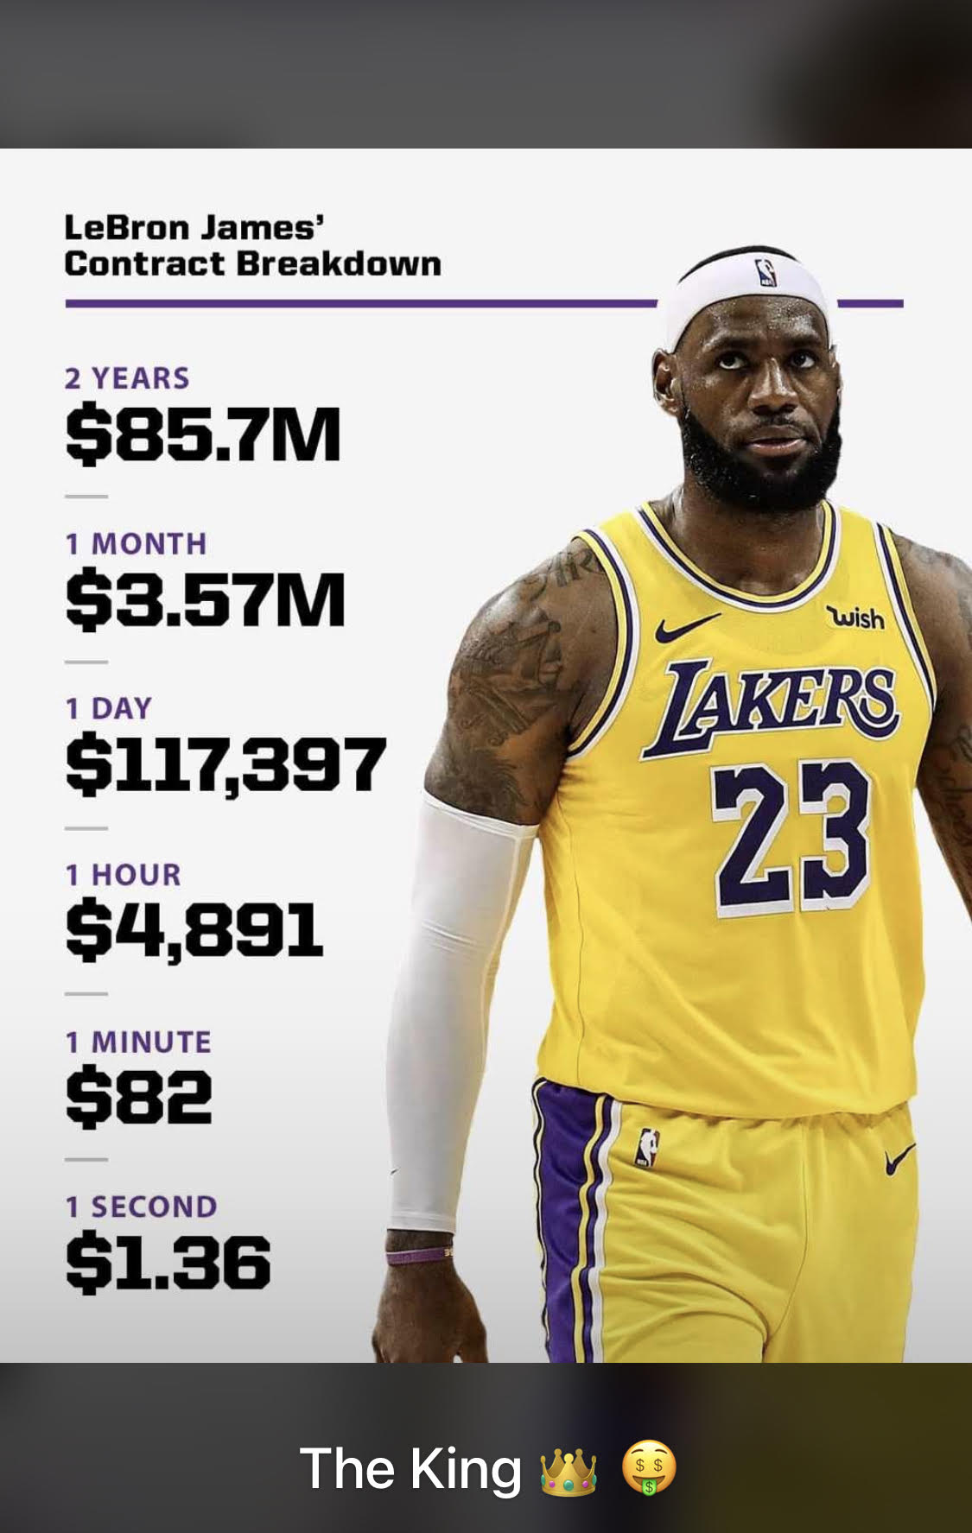
Earn Time
Save time
Spend Time
Note – 24hr per Day
What you do add Value

Slide 6
Core IT Subjects
Data Structures
Algorithms
Master in 2 programming language (Python & Java)
System Designs(Memory Management, cache, processor optimization)

Slide 7
Prepare for challenge
https://coderbyte.com/
https://www.geeksforgeeks.org/practice-for-cracking-any-coding-interview/
https://leetcode.com/
https://www.hackerrank.com/programming-interview-questions/
https://www.kaggle.com/competitions ( Machine Learning)

Slide 8
IT Trends in 2021
Cloud Adaptation – Distributed Cloud ( On-Prem vs Cloud (AWS, Azure, GCP )
Artificial intelligence ( ML, Deep Learning, Computer Vision Etc…….)
Robotics, Drones, and Vehicle Automation
The As-A-Service Revolution ( Pay as you grow)
Extended Reality (XR) – Virtual and Augmented Reality (VR/MR)
Mobile - 5G
Cybersecurity mesh The cybersecurity mesh is a distributed architectural approach to scalable

Slide 9
Any Questions please?

